Slide 1
AG Mixed Relay world Championships
Briefing
Wednesday,16 October 2024
Notes:
A quick guide to introduce you to the various elements that make up the presentation template.
Brand fonts
Arial is our secondary brand font and should be available organisation-wide.
Brand colours
Our colours have been carefully chosen to engage and represent the world of triathlon, appealing to new audiences and resonating with long-time participants. To achieve this, it is important that they are used both carefully and accurately.
The colours have been set up within the theme of this template.
Charts and tables
Using PowerPoint’s default table and chart styles will pull our on-brand colours through automatically.
Colours should be kept flat with no gradients or shadows.
Get started
Click on the drop-down arrow next to the new slide button at the top to reveal the full suite of slides available.

Slide 2
Agenda – Mixed Relay World Championships
Welcome and Introduction
Competition Jury
Schedules and Timetables
Check-in and Procedures
The Course
Post-Race Procedures
Water Quality Test Results
Weather forecast

Slide 3
Welcome and Introductions
Thanos Nikopoulos (GRE), Jamie Gordon (GBR), Hugh McAtamney (IRE), Esther Sánchez (ESP), Aurianne Lacampagne (FRA), World Triathlon Technical Delegates
Dr Luis Coira Nieto (ESP), World Triathlon Medical Delegate
Stéfane Mauris (SUI), Juliet Fahey (NZL), Carmen Gómez (ESP), World Triathlon Head Referees
Jorge Garcia, Event Director
Miguel Fernandez, Race Director

Slide 4
Competition Jury
Age Group Mixed Relay – Sunday
Hugh McAtamney (IRE), Chair
Antonio Alvarez (MEX), World Triathlon Executive Board Representative
Borja Oses (ESP), National Federation Representative

Slide 5
Schedule and Timetables
Saturday 19th October 2024
Saturday, October 19, 2024 | 13:00 |  | AG Mixed Relay | AG Mixed Relay online team declaration close
Saturday, October 19, 2024 | 15:00 | 15:30 | AG Mixed Relay | AG Mixed Relay Team Managers' Meeting - Team Declaration | TOs Lounge
Saturday, October 19, 2024 | 16:00 | 18:00 | AG Mixed Relay | AG Registation (AG Mixed Relay) | Playa de los Alamos venue

Slide 6
Schedule and Timetables
Sunday 20th October 2024
Start | End | Activity | Location
10:00 | 11:00 | Age-Group Mixed Relay Registration | Playa de los Alamos venue
11:00 | 13:00 | Rules Q&A (Transition Zone) | AG Transition Area
11:00 | 19:30 | Age-Group Mixed Relay Bag drop off | Recovery Area
11:00 | 13:00 | Age-Group Mixed Relay Transition check in | AG Transition Area
13:00 |  | TRI AG Mixed Relay Championship | Swim Start
13:20 | 13:53 | Swim cut off (20’ per swimmer)
 | 16:30 | Run cut off
16:45 | 19:30 | Age-Group Mixed Relay Bike check out | AG Transition Area
21:00 | 21:30 | Age-Group Mixed Relay Medal Ceremony | Plaza De Toros

Slide 7
Registration Schedule - Mixed relay
Race pack distribution will be in the expo area.
To pick up it, you will need to show your ID or Passport in the registration.
One of the teammates can ask for the complete pack (only if all athletes have previously raced at Standard, Sprint or Aquabike).

Slide 8
Race packages
Each envelope will have the following 4 X
Swim cap & swim cap decal (check that the colour is correct in the AG Start Times)
Race bib number
Race Stickers: Helmet (3x), Bike (1x)
Personal accreditation wristband
Red Street Wear Bag, only this bag will be allowed in the bag drop off area

Slide 9
Timing Chips
Timing chips for #A will be distributed in Transition Area during the check-in, and it must be returned after the crossing the finish line.
For #B, #C & #D the timing chip will be distributed in the relay exchange zone.
There will be a 30,00€ fine in case you miss to return the chip.

Slide 10
Check-in Procedure
The Team must pass the check in at the same time.
When arriving at the Transition Area the following will take place:
Bicycle will be checked for compliance with World Triathlon Rules
National Federation Uniform will be checked
Swim caps, stickers and bib numbers will be checked

Slide 11
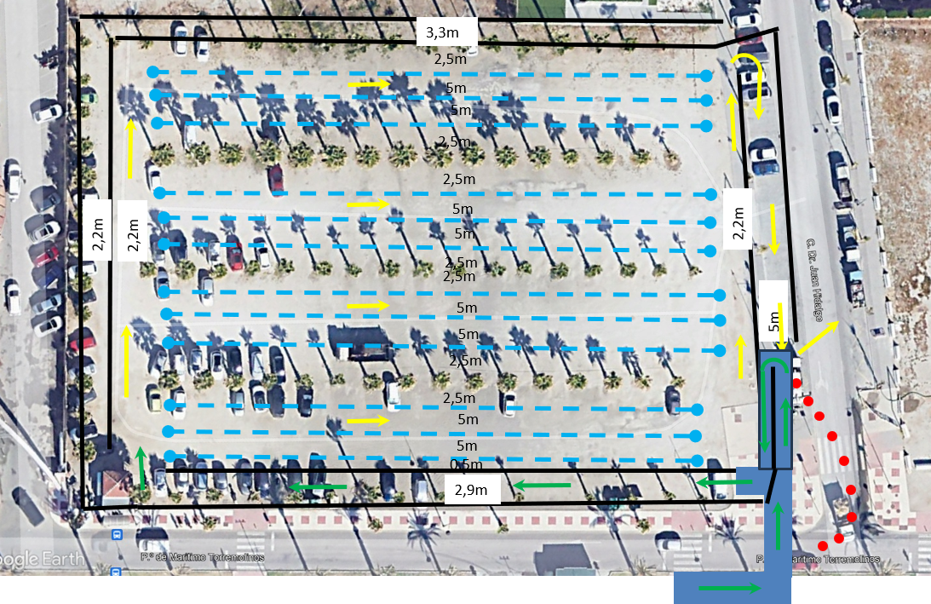
AG Mixed Relay - Race Day Check In
check-in…
Please have your wristband on and your bike & helmet stickers attached
You are only using the top half of transition
REMINDER: the Para athletes will be competing during this time

Slide 12
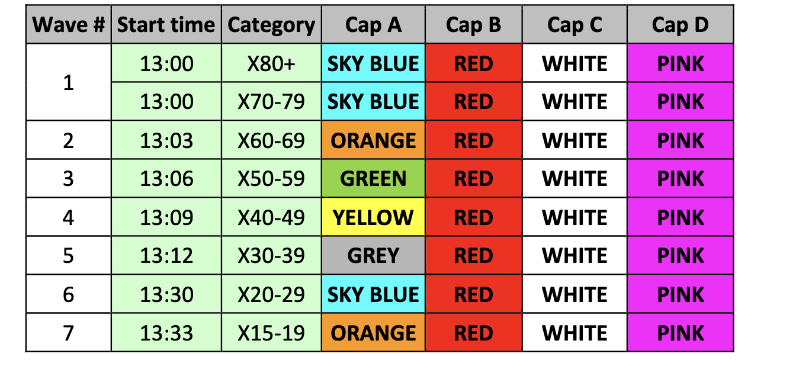
Mixed Relay Start Times

Slide 13
World Triathlon Age Group
Mixed Relay Championships
Swim 250m – 1 lap
Bike 6km –1 lap
Run 1,5km – 1 lap in the seafront
Aid Station at the beginning of the run course
Relay Zone At the end of the run section

Slide 14
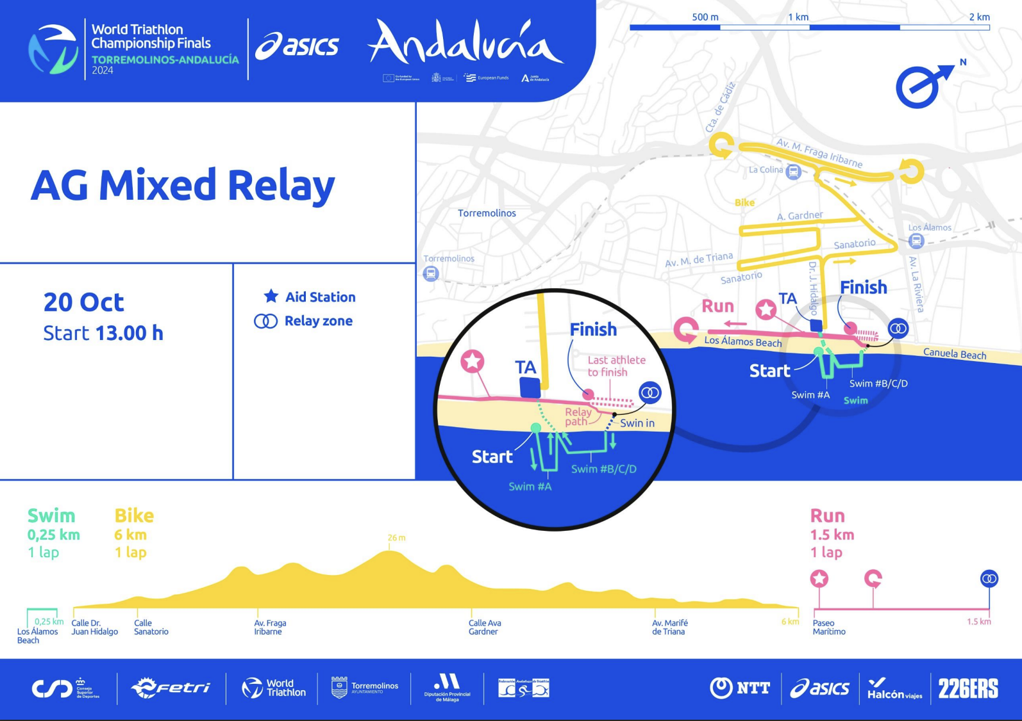
Mixed Relay Course

Slide 15
Start Procedures – Age Group mixed Relay
Athlete A in position - start line A
Follow instructions of the start officials
1 minute before the start, you will be asked to line up and hold position.
The start can be given any time after the Head Referee announces ”On your mark”
Air horn blast: The race starts
Other athletes start in start line B beside the relay change zone

Slide 16
False-start Procedures
False-start (many athletes)
Several horn blasts
Kayaks move in front of you
Everyone goes back to her/his original start spot
False-start (few athletes)
10 seconds penalty served in T1

Slide 17
Swim course
On 16th of October at 10:00 am
WBGT: 19.6°C
Air temperature: 20.3 °C
Water temperature: 19.2 °C
Relative Humidity: 89%
Wetsuits allowed/not allowed. The Head Referee will make the decision on wetsuit use 1 hr before race start.
A athlete - Keep the orange buoys on your LEFT shoulder (counter clockwise)
B/C/D athletes - Keep the yellow buoys on your RIGHT shoulder ( clockwise)
Take cap, goggles to transition into your area
No swim warm up area is provided
Swim exit to transition area path is carpeted.
Aid station is available at the swim exit.

Slide 18
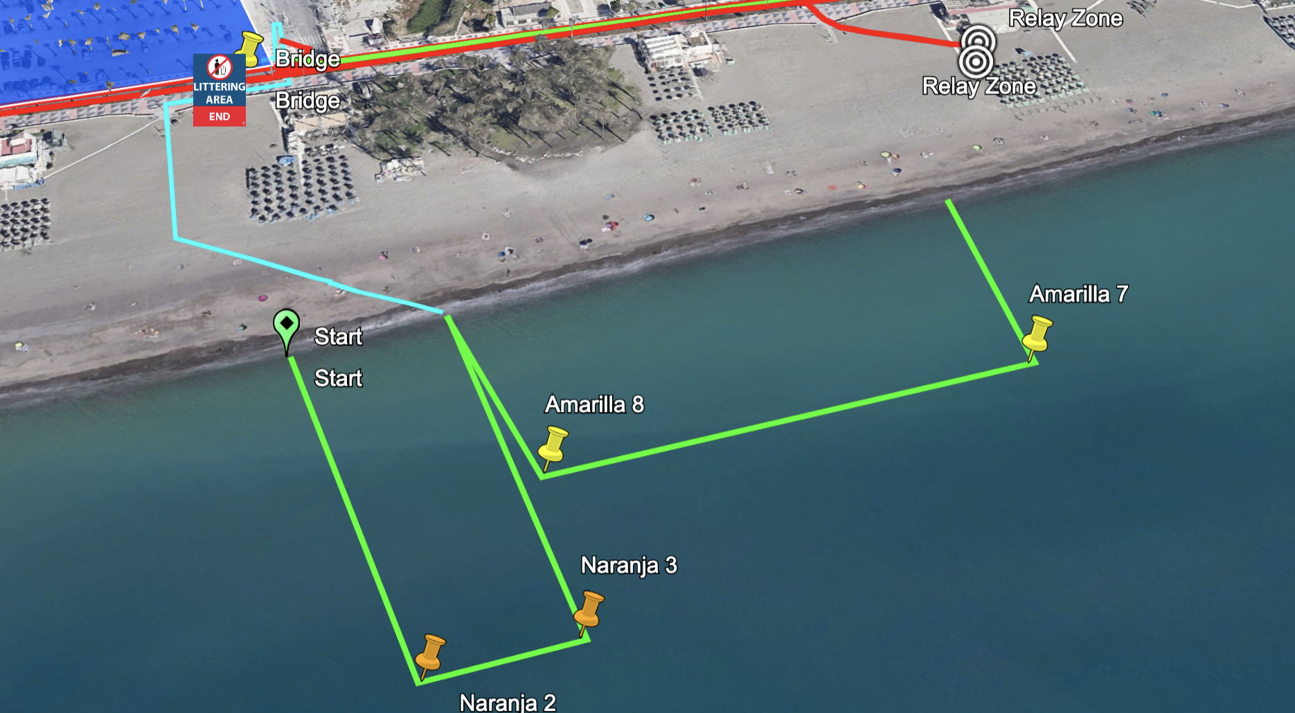
Swim course
Start B,C,D
Start A

Slide 19
Transition Area - details
Traditional Bike Racks – numbered – with A/B/C/D
All equipment within your space
Remember to fasten your helmet before removing your bike from the rack and do not unfasten your helmet until your bike is racked in T2
Race bib number is not mandatory for the bike segment, but MANDATORY for the run
Mount line is at the exit of transition
Dismount line is at the entrance of transition
Mount line is green / Dismount line is red.

Slide 20
Transition Area – T1
Mount Line Here

Slide 21
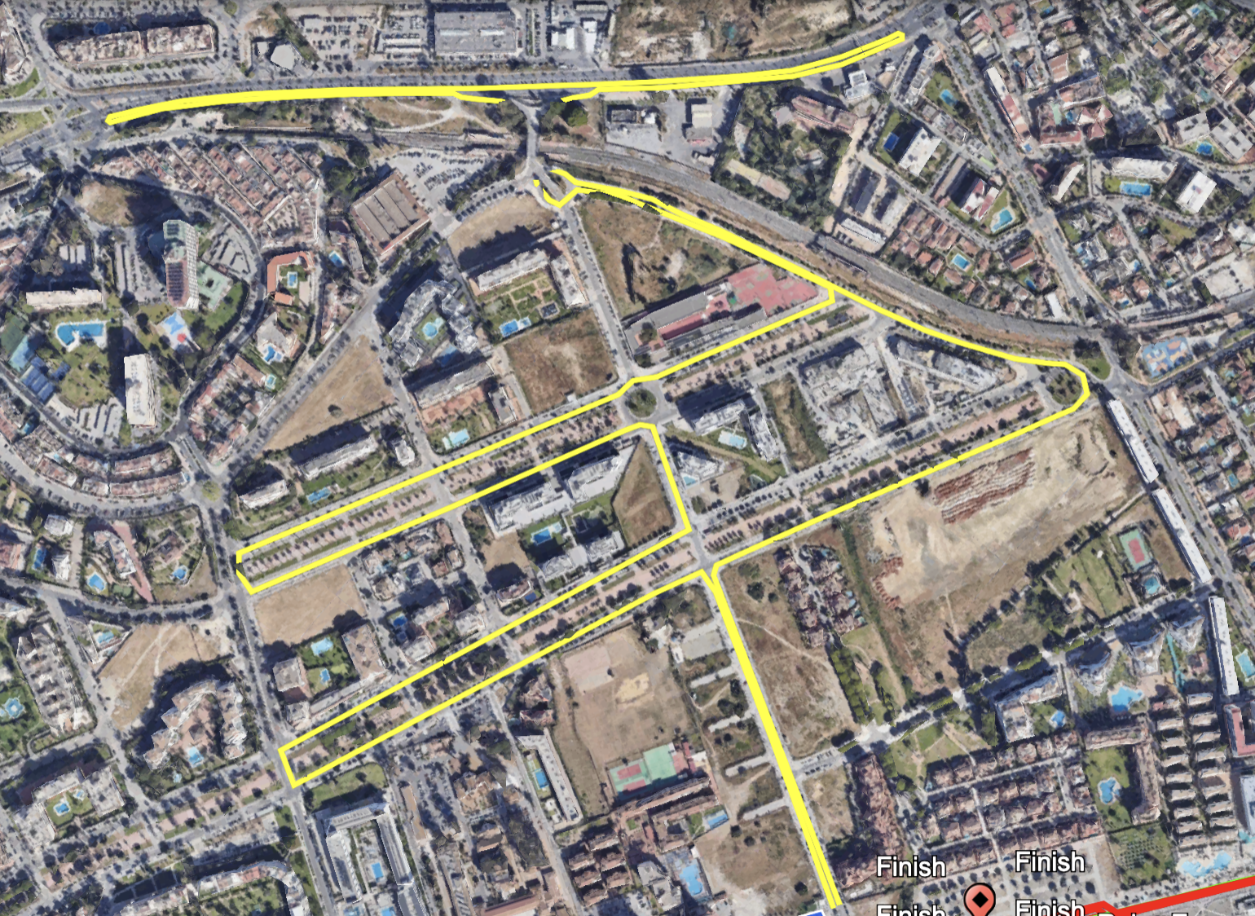
Bike course
Numerous speed-bumps in the city
Drafting is allowed but not within different gender
Always stay on the right and pass on the left
Warn the athlete that you want to pass
Timing mat at the far end U-turn.
Broom car available
penalty box is located just before the turn onto the road leading to the dismount line

Slide 22
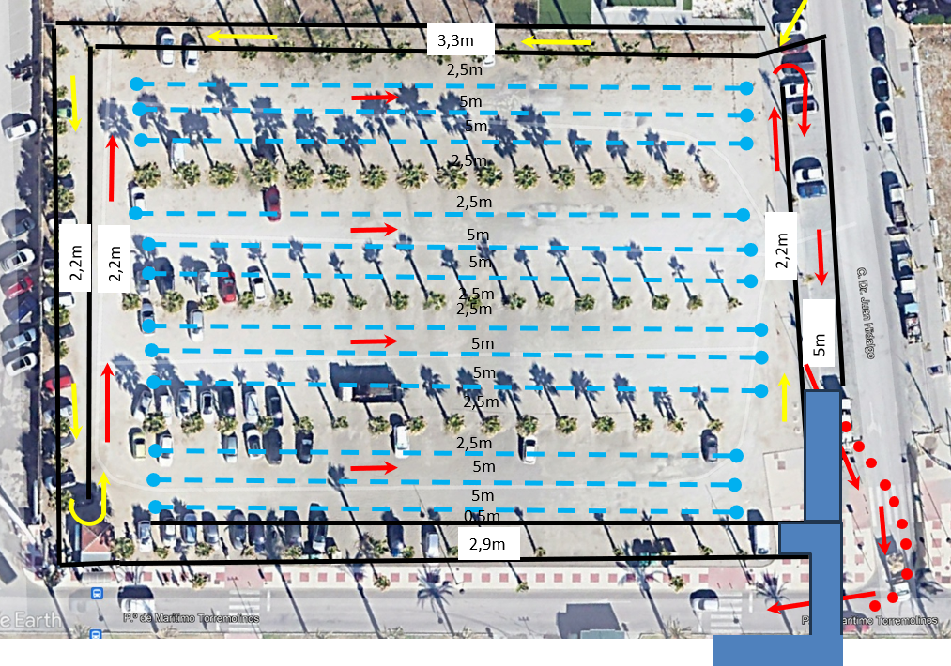
Transition Area – T2
Dismount Mount Line Here?

Slide 23
Run course
Bib number must be worn on the front of the body
1 x Aid stations – accessible from both sides (for locations, see the map)
Water

Slide 24
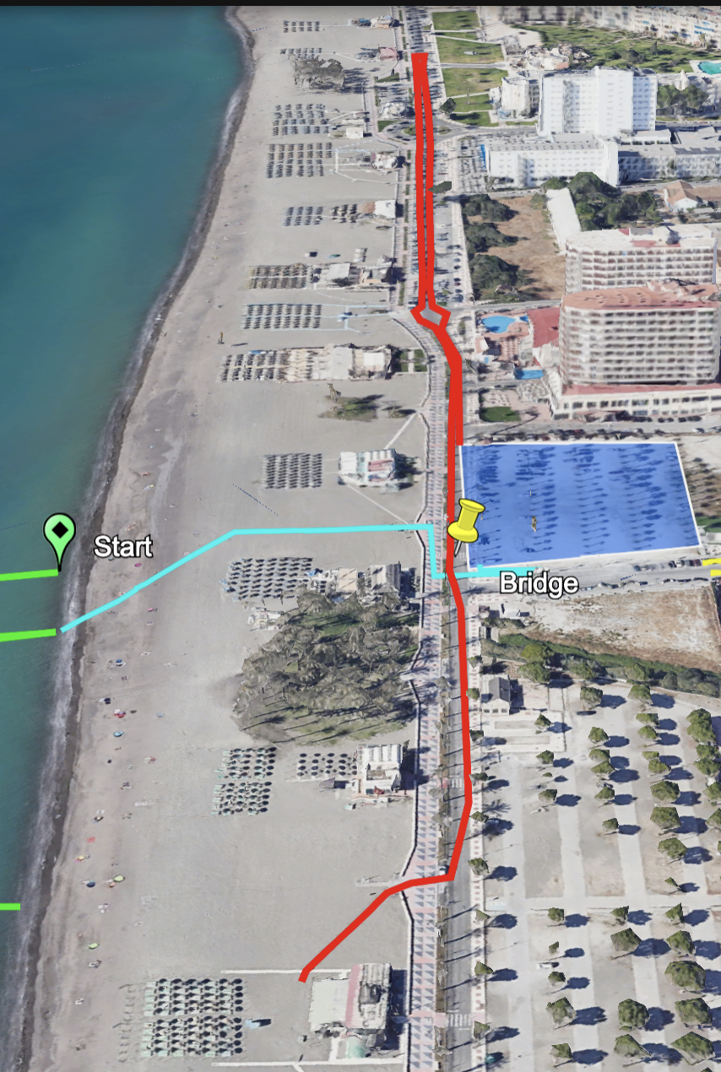
Run (athletes A/B/C)
Athletes exit transition and turn right
at the end of the lap they will exit onto the beach to the Relay Zone
RELAY ZONE

Slide 25
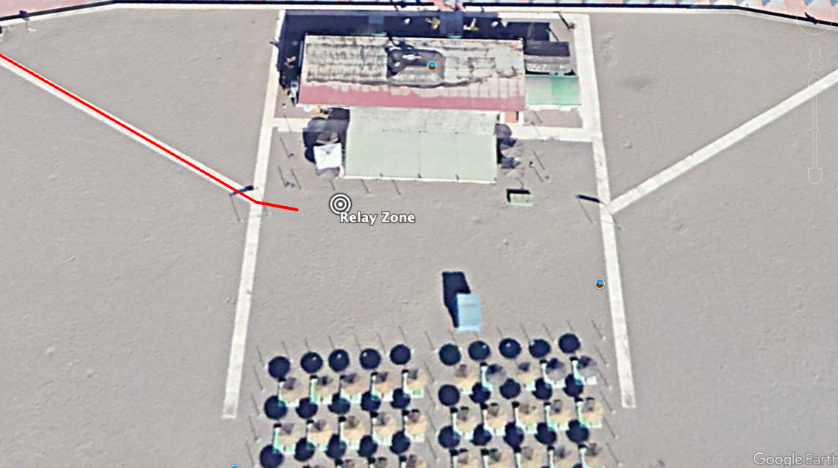
Relay Change Zone / Line Up
Check according to the swim caps
Big Screen
Timing chip distribution
Medical/ recovery, timing chip collection, finisher medal
ENTRY
USA
WAITING AREA
Relay zONE
CAN
MEX/GER
OTHER

Slide 26
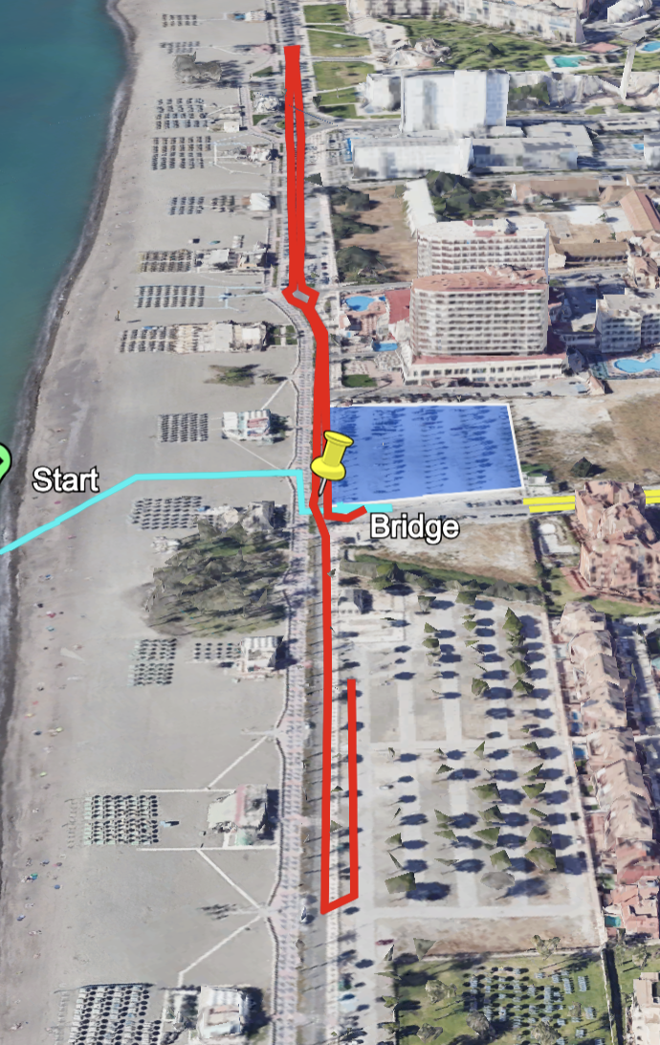
Run (athletes D)
The final athlete on the team will continue past the relay zone and return back down the street into the finish
FINISH

Slide 27
Post-race Procedures
Friends and family members are not permitted at the finish chute and the post finish area (DSQ)
To avoid congestion: go to recovery area after the finish line
Food and drinks available there
Leave the recovery area after having recovered
Collect your bags from bag-drop-off
Team Medical Access:
Only accredited team medical will be allowed to enter the medical tent if invited by the World Triathlon Medical Delegate’s permission.

Slide 28
Results and Medal Ceremony
Available on the World Triathlon website.
Medal Ceremonies will be on Sunday the 20th at 21:00– 21:30
These will be held at Plaza de Toros venue on the Main Stage
Medalling TEAMS are requested to be at the meeting-point 15 minutes before. Be punctual as we must start on time.
As per the World Triathlon Competition rules:
2.8 c.) (i) Athletes must wear the uniform during the entire competition and award ceremony. Long sleeves and long pants are allowed for the award ceremony
If you can not attend the medal ceremony, your Team Manager or one of your teammates should pick up your medal at the end of the ceremony.

Slide 29
Bike Infringements (yellow card)
For a Draft LEGAL event
Drafting between athletes from a different gender is not allowed (1st offence Warning+Amend; 2nd offence DSQ)
During the Bike segment, Technical Officials can show a YELLOW card = Time Penalty
Time Penalty = 10 seconds. Must be served in the NEXT Penalty Box
Littering areas attached to each run penalty box
Other infringements (blocking, littering, riding in dangerous position, etc.)

Slide 30
Advice of Penalties
The official will
Sound a whistle or horn
Show a YELLOW card
Call your number
Advise you of the penalty
If you are shown a RED card, you are disqualified

Slide 31
Penalties
Start + Swim infringements are served in T1 by that athlete
For other penalties athletes can be penalised on the spot or in transition
Penalties are 10 seconds

Slide 32
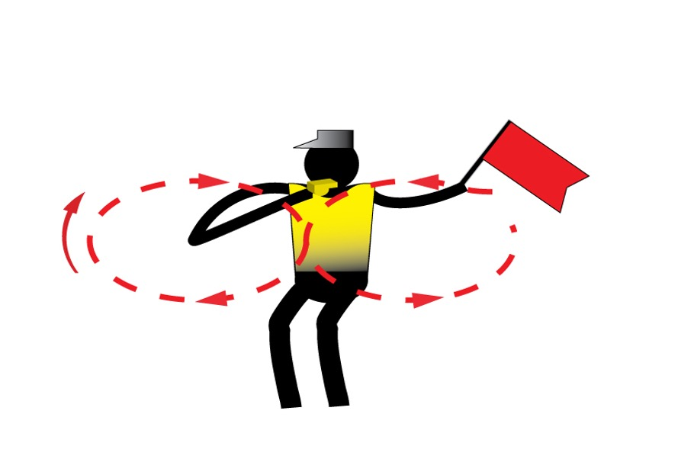
Caution
Caution signal: three sharp whistles and red flags

Slide 33
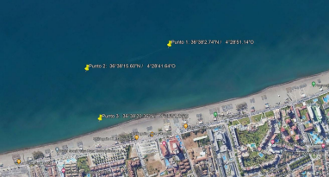
Water Quality Assessment
Enterococci
16/08/2023 | NMP/100mL
Location 1 | 0
Location 2 | 0
Location 3 | 0
Enterococci limit | <100
E.Coli
17/09/2023 | NMP/100mL
Location 1 | 110
Location 2 | 80
Location 3 | 55
E.Coli limit | <250
PH
17/09/2023
Location 1 | 7,66
Location 2 | 8
Location 3 | 7,86
PH limit | 6-9
Visual Sanitary Inspection (last 12 hours)
Location | Visual Pollution | Odour | Time of visit | Comments
 | None | None
Water samples were taken in three different points (see image below).
SUMMARY
1 = ‘Very Good Water Quality’: Enterococci < 100 E.Coli < 250 PH between 6-9 No visual pollution during sanitary check No forecasted heavy rain
Notes:
Water Quality Decision Matrix (Sea and Transition water)
1 = ‘Very Good Water Quality’: (E.Coli < 250 or Enterococci < 100) with no or potential visual pollution during sanitary check or forecasted heavy rain;
2 = ‘Good Water Quality’: (E.Coli < 250 or Enterococci < 100) with poor visual pollution during sanitary inspection or forecasted heavy rain;
2 = ‘Good Water Quality’: (E.Coli: 250 to 500 or Enterococci 100 to 200) but with no or potential visual pollution during sanitary inspection or forecasted heavy rain;
3 = ‘Fair Water Quality’: (E.Coli: 250 to 500 or Enterococci 100 to 200), but with potential or poor visual pollution during sanitary check and/or potential for forecast of heavy rain;
4 = ‘Poor Water Quality’: (E.Coli > 500 or Enterococci > 200), with any visual pollution during sanitary check and/or potential for forecast of heavy rain.
Water Quality Decision Matrix (Inland water)
1 = ‘Very Good Water Quality’: (E.Coli < 500 or Enterococci < 200) with no or potential visual pollution during sanitary check or forecasted heavy rain;
2 = ‘Good Water Quality’: (E.Coli < 500 or Enterococci < 200) with poor visual pollution during sanitary inspection or forecasted heavy rain;
2 = ‘Good Water Quality’: (E.Coli: 500 to 1000 or Enterococci 200 to 400) but with no or potential visual pollution during sanitary inspection or forecasted heavy rain;
3 = ‘Fair Water Quality’: (E.Coli: 500 to 1000 or Enterococci 200 to 400), but with potential or poor visual pollution during sanitary check and/or potential for forecast of heavy rain;
4 = ‘Poor Water Quality’: (E.Coli > 1000 or Enterococci > 400), with any visual pollution during sanitary check and/or potential for forecast of heavy rain.

Slide 34
Weather Forecast TBC

Slide 36
Access to briefing
https://triathlon.org/about/downloads/category/race_briefings

Slide 37
Good luck!
¡Buena suerte!

