Slide 1
Branding instructions to complete your briefing
Use ONLY Arial font. No other font should be used. Minimum font size = 20pt
The template has predefined brand colors. Try to use these colors before any others.
Only the official World Triathlon event logo can be placed on this briefing and no others. Please get it from your LOC. The one on the cover should be on the white version on transparent background
Only use the front cover given to you
You can apply different predefined layout for the text slides but the above must be respected
If you need to highlight some information, use the Blue Text 1 from the World Triathlon color palette

Slide 2
Elite Athletes’ briefing
<insert date of briefing>
Insert official World Triathlon event logo, white version
Notes:
A quick guide to introduce you to the various elements that make up the presentation template.
Brand fonts
Arial is our secondary brand font and should be available organisation-wide.
Brand colours
Our colours have been carefully chosen to engage and represent the world of triathlon, appealing to new audiences and resonating with long-time participants. To achieve this, it is important that they are used both carefully and accurately.
The colours have been set up within the theme of this template.
Charts and tables
Using PowerPoint’s default table and chart styles will pull our on-brand colours through automatically.
Colours should be kept flat with no gradients or shadows.
Get started
Click on the drop-down arrow next to the new slide button at the top to reveal the full suite of slides available.

Slide 3
Agenda
Welcome and Introductions
Competition Jury
Schedules and Timetables
Check-in and Procedures
The Course
Post-Race Procedures
Water Quality Test Results
Weather forecast

Slide 4
Welcome and Introductions
<Insert name>, <highest ranked World Triathlon/ Continental Executive Board representative>
<Insert name>, World Triathlon Team Leader {if applicable}
<Insert name>, World Triathlon Technical Delegate
<Insert name>, World Triathlon Assistant Technical Delegate {if applicable}
<Insert name>, World Triathlon Medical Delegate {if applicable}
<Insert name>, World Triathlon Head Referee
<Insert name>, LOC Director
{comment – to be deleted: Insert the names of the officials that are attending the briefing and delete the rest}
Insert official World Triathlon event logo,
color version

Slide 5
Competition Jury
<Insert name>, Chair
<Insert name>
<Insert name>
{comment – to be deleted: Insert the names of the Competition Jury Members, add two more member for World Triathlon Series Grand Final elite competitions}
Insert official World Triathlon event logo,
color version

Slide 6
Schedule and Timetables
FRIDAY {Thursday if the briefing is on Thursday}
hh:mm – hh:mm Race pack pick-up (after athletes’ briefing)
hh:mm – hh:mm Pasta Party {if applicable}
Insert official World Triathlon event logo,
color version

Slide 7
Schedule and Timetables
SATURDAY {Friday if the briefing is on Thursday}
hh:mm – hh:mm Training sessions in the swimming pool {if applicable}
hh:mm – hh:mm Bike course familiarisation {if applicable}
Meeting point: <insert meeting point>
hh:mm – hh:mm Swim course familiarisation {if applicable}
Insert official World Triathlon event logo,
color version

Slide 8
Schedule and Timetables
SUNDAY {Saturday if the briefing is on Thursday}
hh:mm – hh:mm Athletes’ Lounge check-in
hh:mm – hh:mm Transition Area check-in for Elite Men/Women {select the appropriate}
hh:mm – hh:mm Swim Warm-up for Elite Men/Women {select the appropriate}
hh:mm Athletes’ Introduction
hh:mm Elite Men/Women Start {select the appropriate}
hh:mm – hh:mm Medal ceremony
{comment – to be deleted: Additional information can be added}
Insert official World Triathlon event logo,
color version

Slide 9
Schedule and Timetables
SUNDAY {Saturday if the briefing is on Thursday}
hh:mm – hh:mm Athletes’ Lounge check-in
hh:mm – hh:mm Transition Area check-in for Elite Men/Women {select the appropriate}
hh:mm – hh:mm Swim Warm-up for Elite Men/Women {select the appropriate}
hh:mm Athletes’ Introduction
hh:mm Elite Men/Women Start {select the appropriate}
hh:mm – hh:mm Medal ceremony
{comment – to be deleted: Additional information can be added such as «buses leave for the closing ceremony from ….. at hh:mm»}
Insert official World Triathlon event logo,
color version

Slide 10
Race Pack Distribution
ALL athletes/support team must provide a picture ID to receive the package.
Your package includes:
- Stickers – Helmet (3x), Bike (1x), Bag (1x) Stickers
- Body decals – both arms and both legs {if applicable}
- Accreditation - gives access to access lounge on race day
Insert official World Triathlon event logo,
color version

Slide 11
Check-in procedures
{if applicable}
Team officials entering the venue
  Using the shuttle service from the ……………
  Schedule
    <pickup location> to <drop off location>: hh:mm, hh:mm, hh:mm,
    <pickup location> to <drop off location>: hh:mm, hh:mm, hh:mm,
Insert official World Triathlon event logo,
color version

Slide 12
Check-in procedures
Athletes Lounge (Bike check)
Bike frame
Wheels and spare wheels (non authorized UCI wheels rule)
  Disc brakes are now legal and spare wheels with disc brakes may be placed at the team wheel station however they are not allowed in the neutral wheel station
Leave your spare wheels to the Bike Check {if applicable}
  Saddle position (-5cm ≤ Men & -2 cm ≤ Women) - approved exceptions on World Triathlon website
Only traditional handlebars (clips-on to be removed)
  Approval for the addition/modification of any equipment to the bike MUST be obtained from the Head Referee at the end of the athletes’ briefing
  Mechanic service available
Insert official World Triathlon event logo,
color version

Slide 13
Check-in procedures
Athletes’ Lounge
Uniform & race gear check (name, country, logos, World Triathlon logo) – photos taken of each uniform. Wearing other uniform during the race = DSQ
Swim skins have to follow uniform guidelines and must be worn throughout the race.
Body marking check (both arms, both legs)
Timing chip distribution (1 for the ankle/ 2 for each ankle choose the correct)
Swim cap distribution
If an athlete wishes to wear a second swim cap, the cap should be unbranded.
Leave your bag in the Athletes’ Lounge they will be taken to the
Recovery Area {if applicable}
Insert official World Triathlon event logo,
color version

Slide 14
Map Athletes’ Lounge - Check-in procedures
<Insert athletes’ lounge map, if applicable>
Insert official World Triathlon event logo,
color version

Slide 15
Check-in procedures {if only 1 TA}
Transition Area
Helmet check - Don’t leave your helmet fastened in the transition
The athlete who misses to comply with this rule will receive a time penalty in TA1.
Running Shoes outside the box, helmet on the bike
No clip-on handlebar is allowed on draft-legal event
To add any equipment to the bike, you must obtain approval from the Head Referee up until 10 minutes after the end of the Athletes‘ Briefing.
Insert official World Triathlon event logo,
color version

Slide 16
Check-in procedures {if only 2 TAs}
Transition Area 1 (close to swim start)
Helmet check - Don’t leave your helmet fastened in the transition
The athlete who misses to comply with this rule will receive a time penalty in TA1.
Helmet on the bike
No clip-on handlebar is allowed on draft-legal event
Transition Area 2 (Next to finish chute)
Running Shoes outside the box
In an individual bike rack, the bike must be racked in the first transition by the rear wheel and in the second transition by either of the wheels.
Insert official World Triathlon event logo,
color version

Slide 17
Pre-start Procedures
Athlete Introduction
10 minutes before start - line-up {insert location}
Jog to the start pontoon once your name is called
Select your position and stay behind the line!
Athlete’s are required to wear the official swim cap from the moment of the athletes’ line-up
Insert official World Triathlon event logo,
color version

Slide 18
Pre-start Procedures – Line-up map
<Insert line up map, if applicable>
Insert official World Triathlon event logo,
color version

Slide 19
Start Procedures
Athlete in position
The start can be given any time after the TD/ HR {choose the correct} announces
”On your mark”
Electronic horn blast / Air horn blast {choose the correct}
The race starts
Athletes not moving forward at the start will receive a time penalty in TA1.
Insert official World Triathlon event logo,
color version

Slide 20
False-start Procedures
False-start (many athletes)
Several horn blasts
Kayaks move in front of you
Everyone goes back to her/his original start spot
Valid start with early starters
If a few athletes start before the horn and everyone else starts with the horn, the false starter(s) will receive a 15/10 second {choose the correct} penalty in TA1.
During the time penalty, the athlete(s) may NOT touch any equipment.
Insert official World Triathlon event logo,
color version

Slide 21
The course
Swim <number> lap(s) of <length of one lap>m
Bike <number> laps of <length of one lap>km
Run <number> laps of <length of one lap>km

Slide 22
The course
<Insert TV Show Animation/map, if applicable>
Insert official World Triathlon event logo,
color version

Slide 23





Swim course
Keep only the flag corresponding to the WBGT reading and remove the others
On {date} at {hh:mm}: Water: <water temperature> °C
Air: <air temperature> °C
WBGT: <air temperature> °C
Wetsuit allowed / Wetsuit not allowed {choose the correct or mention decision taken 1h before the race}
<number of laps> laps (total distance of <total length of the swim in meter>m)
Distance to the first turn buoy <length in meter>m
Take cap, goggles to transition into your box
Insert official World Triathlon event logo,
color version

Slide 24
Swim behavior
Definition from the World Triathlon CR §4.1:
e.) Athletes may sportingly maintain their own space in the water:
Where athletes make accidental contact in the swim and then immediately afterwards move apart no penalty will be incurred;
Where athletes make contact in the swim, and an athlete continues to impede the progress of the other athlete without moving apart, this action will result in a time penalty;
Where athletes deliberately target another athlete to impede their progress, gain unfair advantage and potentially cause harm will result in disqualification and may be reported to World Triathlon Arbitration Tribunal for potential suspension or expulsion.
Insert official World Triathlon event logo,
color version

Slide 25
Swim conduct
There will be additional boats and Technical officials deployed on the swim course to monitor athlete’s behaviour in this respect .
Infringements may be recorded and appropriate action will be taken dependant on the rules definition from the previous slide .
Please respect your fellow competitors and keep the race fair.
Insert official World Triathlon event logo,
color version

Slide 26
Swim course map
<Insert Swim Course Map>
Insert official World Triathlon event logo,
color version

Slide 27
Swim exit to TA
<Insert Swim Exit to TA Map>
Insert official World Triathlon event logo,
color version

Slide 28
Transition Area {first choice}
Swim Exit to TA <meters> m
Traditional Bike Racks – one row / two rows {choose the correct}
All used equipment into the box
Mount line at the end of the TA
Insert official World Triathlon event logo,
color version

Slide 29
Transition Area {second choice}
Swim Exit to TA <meters> m
Individual Bike Racks – number, name and country flag
In case of individual bike rack, the bike must be racked in the first transition by the rear wheel and in the second transition by either of the wheels
Used equipment into the box
By the end of the last transition, ALL equipment (used + unused) must be deposited in the corresponding bin.
Athletes cannot touch the locking mechanism of their helmet from the time they remove their bike from the rack until they have placed it back on the rack and let go after the finish of the bike segment.
Mount line (green), Dismount line (red) {show location on map}
Insert official World Triathlon event logo,
color version

Slide 30
Transition Flow
<Insert Swim Exit to TZ Map, show where #1 is on the map for TA1 and TA2>
Insert official World Triathlon event logo,
color version

Slide 31
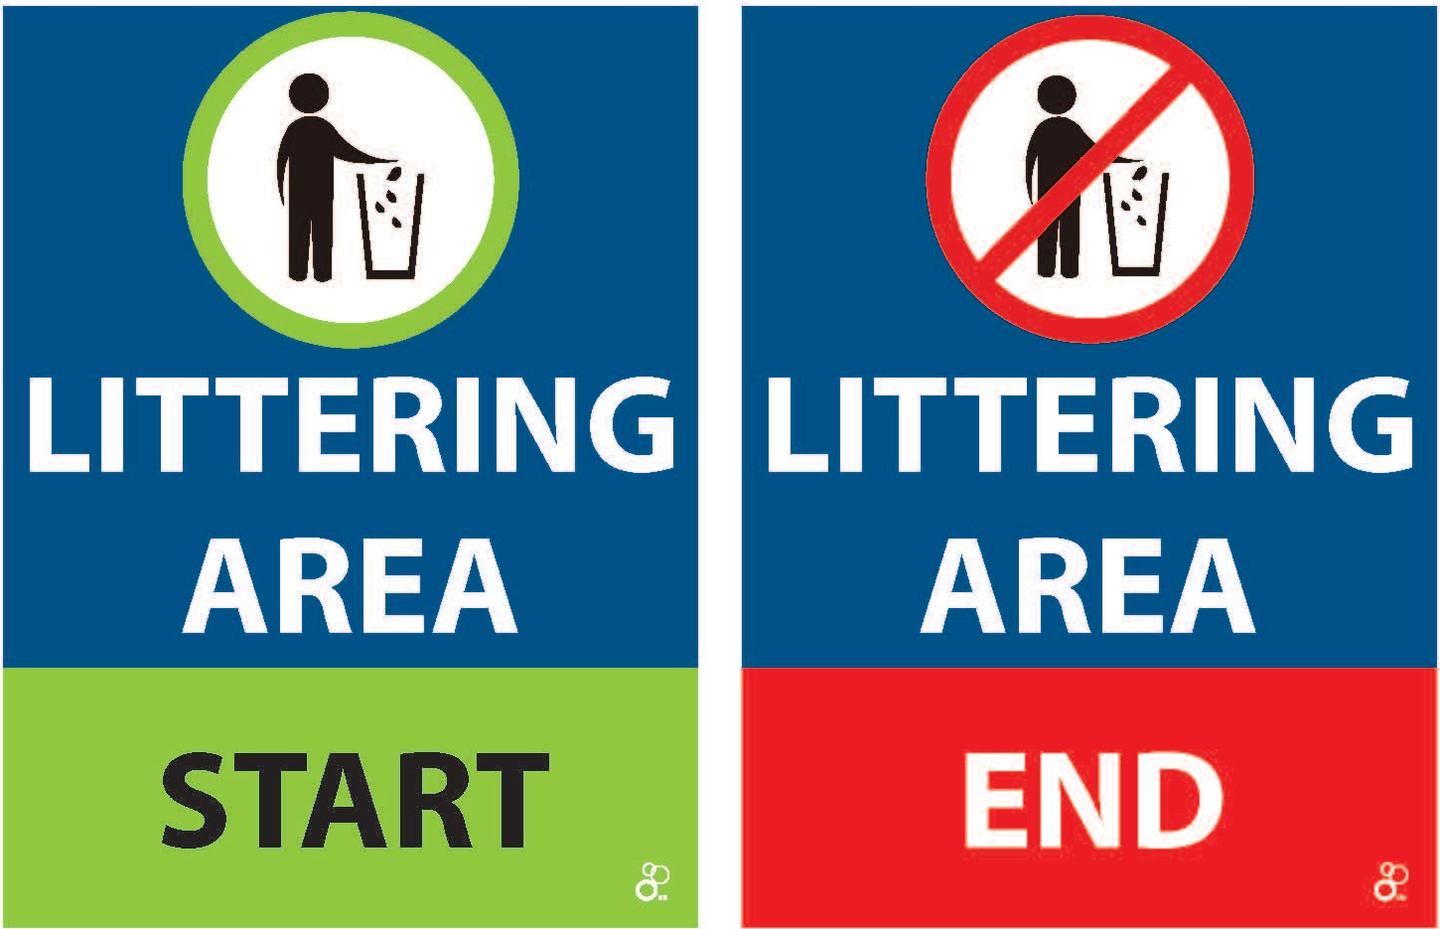
Bike course
<number of laps> laps (total distance of <total length of the bike in kilometer>km)
Hilly / flat and technical / not technical {choose the correct}
2 Wheel Stations
  1 Neutral wheel station {comment to be deleted: list the type of the provided wheels}
  1 Team wheel station
  For locations see the map
Lap Counter: at the <location of the Lap counter>
Littering Zones - <locations>
Lapped athletes are out of the race
First runner – last biker scenario {if applicable}
Insert official World Triathlon event logo,
color version

Slide 32
Riding position
OK
NOT OK
Only ok in draft illegal event
Insert official World Triathlon event logo,
color version

Slide 33
Bike behavior
Definition from the World Triathlon CR §5.1.b:
Where an athlete cuts across or makes accidental contact with another athlete during the bike, then immediately moves away and does not cause a crash the athlete will not incur a penalty.
Where an athlete cuts across another athlete in a dangerous manner or makes contact with another athlete during the bike, does not move away and continues to impede the progress of the other athlete, the athlete will incur a time penalty.
Where an athlete deliberately targets another athlete during the bike and impedes their progress, gains an unfair advantage, potentially causes harm or a crash the athlete will be disqualified and may be reported to the World Triathlon Tribunal for potential suspension or expulsion.
Insert official World Triathlon event logo,
color version

Slide 34
Bike Course Map
<Insert Bike Course Map (show locations of wheel station, lap counter, littering zones and any hazards on the course) (clarify if the athletes will be passing through the TZ on every lap)>
Insert official World Triathlon event logo,
color version

Slide 35
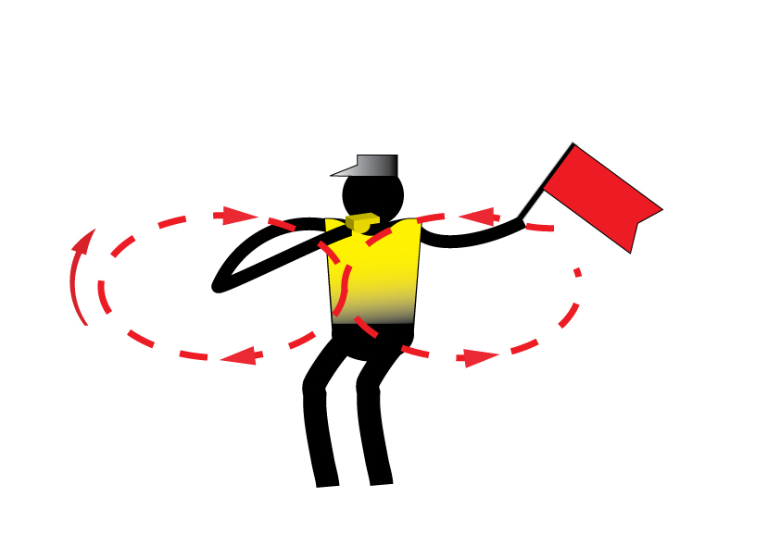
Caution
Insert official World Triathlon event logo,
color version

Slide 36
Bike to Run
<Insert Bike to Run map through TA2>
Insert official World Triathlon event logo,
color version

Slide 37
Run course
<number of laps> laps (total distance of <total length of the bike in kilometer>km)
Aid stations:
  <number> per lap
  For locations see the map
  Sealed water and ice {if applicable}
  Discard plastic bottles and litter within the littering zones indicated by the signs below
Photo-finish {if applicable}
Congestion in finish area >>> Go to mixed zone / recovery area
Insert official World Triathlon event logo,
color version

Slide 38
Run behavior
Definition from the World Triathlon CR §6.1:
Where an athlete makes accidental contact during the run with another athlete, then immediately moves away and does not cause a fall the athlete will not incur a penalty.
Where an athlete makes contact with another athlete during the run, continues to impede the progress of the other athlete and does not move away, the athlete will incur a time penalty.
Where an athlete deliberately targets another athlete during the run and impedes their progress, gains an unfair advantage, potentially causes harm or a fall the athlete will be disqualified and may be reported to the World Triathlon Tribunal for potential suspension or expulsion.
Insert official World Triathlon event logo,
color version

Slide 39
Run equipment - shoes
World Triathlon follows World Athletics' Shoe Regulations applicable to road events for all the triathlon and its other related multisports as described in 1.1.a);
Athletes are subject to random shoe control before, during, or after any competition. For any shoe that cannot be identified, each piece of information (and maybe the shoe itself) will be required to be sent to the World Triathlon headquarters for verification within 7 days after the competition it was worn.
In the official results, the athletes under shoe review will have a note (Uncertified/UNC) added to the results footer notes. If the shoe is confirmed as legal, the note will be removed. In any different case, the athlete will be disqualified.
Insert official World Triathlon event logo,
color version

Slide 40
Run Course Map
Insert Run Course Map (show locations of aid station, lap counter, penalty box & finish chute)
Insert official World Triathlon event logo,
color version

Slide 41
Run Lap
Insert Run Course Map (clarify if the athletes will be passing through the TZ on every lap)
Insert official World Triathlon event logo,
color version

Slide 42
Finish
Insert Finish map to show the way into the finish chute
Insert official World Triathlon event logo,
color version

Slide 43
Run Penalty Box
Start infringements will be served in T1
Swim, T1, Bike, T2 and Run Infringements will be served in Run
Location: {include the exact location} m before the Transition Area
Information: White board to show race numbers and letters to indicate violations
(Athletes need to read the board – coaches are advised to check and inform their athletes)
Procedure: {include the exact seconds} time penalty served on any lap of the run
Penalties must be posted prior to the last lap on the run. Any penalties following that point will be served on the spot.
Athletes have the option to decide whether to stop at the penalty box and serve the penalty or continue to the finish. Not stopping will result in DSQ on crossing the finish line. The athlete
may then protest the penalty. Evidence will only be made available if an
protest is filed.
Insert official World Triathlon event logo,
color version

Slide 44
Run Penalty Box
Rule interpretation
Mount after the mount line: An athlete’s foot must contact the ground past the mount line, before the athlete mounts the bike. If this contact doesn’t occur, it is considered an infringement of the rules (M).
Dismount before the dismount line: An athlete’s foot must contact the ground before the dismount line after the athlete dismounts the bike. If this contact doesn’t occur, it is considered an infringement of the rules (D).
Discharge or store your equipment inside your designated area: Leaving the equipment (swim cap, goggles, helmet, etc.) in the designated box. If leaving the equipment outside the box, it is considered an infringement of the rules (E).
Insert official World Triathlon event logo,
color version

Slide 45
Run Penalty Box
Violations Abbreviations:
For example:
Dismount Line | D |  | Littering | L
Mount Line | M |  | Equipment outside the box | E
Swim Behavior | S |  | Bike Behavior | B
Run Behavior | R |  | Other violations | V
12 D | athlete #12 received a time penalty for a dismount line violation
12x2 ME | athlete #12 received 2-time penalties for mount line and equipment outside the box violations
Insert official World Triathlon event logo,
color version

Slide 46
Post-race Procedures
“Mixed Zone” - immediately after finish 1, 2, 3 with host broadcaster first.
Medal Presentation – protocol – at <hh.mm>
Elite/U23/Junior athletes are not allowed to carry their country flag on the podium; there will be flags raising with the playing of the national anthem of the winner.
Prize money {insert procedure}
Insert official World Triathlon event logo,
color version

Slide 47
Ambush Marketing Rules
For ceremony awards, please dress up with race uniform (or country uniform)
Ambush marketing rules apply.
Race caps/visors are allowed at the podium
Ambush marketing is defined as:
“Deliberately using the opportunity of live television and media photographers to acquire additional exposure for your sponsor product, apparel or brand.”
Please follow the ambush marketing rule
The consequence for this behavior is: (if applicable)
The athlete will immediately forfeit their prize money for that event.
Insert official World Triathlon event logo,
color version

Slide 48
Post-race Procedures
Anti-Doping Control
  Photo ID is needed for every athlete to have ready for Doping Control
Medical
  Only accredited team medical will be allowed to enter the medical tent after the LOC Doctor’s permission.
Insert official World Triathlon event logo,
color version

Slide 49
Right to protest
An Athlete who receives a penalty may protest, with the exception of:
  (i) a penalty for a drafting violation; and
  (ii) a time penalty which has already been served.
If an athlete serves a time penalty, the athlete accepts the penalty, and no protest will be admitted.
If an athlete does not serve a time penalty, he/she will be disqualified but may protest against the disqualification and the decision of the Head Referee to issue the time penalty.
Insert official World Triathlon event logo,
color version

Slide 50
Coaches Accreditation / Coaches Areas
Accreditation
  All coaches have to collect accreditation to be able to enter the venue.
  Only Coaches/Support Crew who have been registered from their NF into the World Triathlon online system are entitled for an accreditation
  Support to the athletes is composed by the following categories: Coaches, Medical, Bike Mechanic, Ski man and NF representatives. World Triathlon may add other categories if needed in a specific event. The people entered in the categories of Coaches and Medical must complete the Anti-Doping Education course.
Coaches’ areas
  Behind / beside / at <location> {describe exactly, choose the correct)
  Show map if available
Insert official World Triathlon event logo,
color version

Slide 51
Important updates
{If applicable}
Insert official World Triathlon event logo,
color version

Slide 52
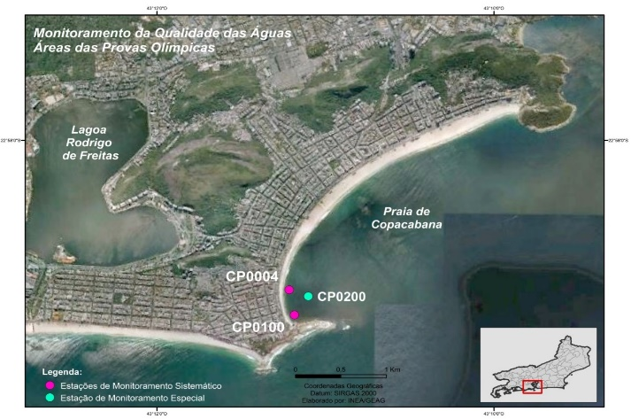
Water Quality Assessment (Sea/Transition)
{select the appropriate}
Update orange text accordingly
Enterococci
Insert Sample Date | NMP/100mL
Location A | 10
Location B | 10
Location C | 10
Enterococci limit | <100
E.Coli
Insert Sample Date | NMP/100mL
Location A | 80
Location B | 80
Location C | 80
E.Coli limit | <250
PH
Insert Sample Date
Location A | 7
Location B | 7
Location C | 7
PH limit | 6-9
Weather forecast
Day | Weather
Briefing (B) | Overcast with light rain
B +1 | Overcast (20% chance of rain
Race Day | Overcast (20% chance of rain
Weather report
Day | Weather
B-3 | Heavy rain in the evening
B-2 | Sunny
B-1 | Sunny
Visual Sanitary Inspection (last 12 hours)
Location | Visual Pollution | Odour | Time of visit | Comments
Location | None | None | 09:15 | Insert comments if necessary
SUMMARY
Add text from competition rules – 10.3.f.i or 10.3.g.i YOU CAN FOUND IT IT THE SLIDE NOTES BELOW, eg. 3 = ‘Fair Water Quality’: (E.Coli: 250 to 500 or Enterococci 100 to 200), but with potential or poor visual pollution during sanitary check and/or potential for forecast of heavy rain;
Insert official World Triathlon event logo,
color version
Notes:
Water Quality Decision Matrix (Sea and Transition water)
1 = ‘Very Good Water Quality’: (E.Coli < 250 or Enterococci < 100) with no or potential visual pollution during sanitary check or forecasted heavy rain;
2 = ‘Good Water Quality’: (E.Coli < 250 or Enterococci < 100) with poor visual pollution during sanitary inspection or forecasted heavy rain;
2 = ‘Good Water Quality’: (E.Coli: 250 to 500 or Enterococci 100 to 200) but with no or potential visual pollution during sanitary inspection or forecasted heavy rain;
3 = ‘Fair Water Quality’: (E.Coli: 250 to 500 or Enterococci 100 to 200), but with potential or poor visual pollution during sanitary check and/or potential for forecast of heavy rain;
4 = ‘Poor Water Quality’: (E.Coli > 500 or Enterococci > 200), with any visual pollution during sanitary check and/or potential for forecast of heavy rain.
Water Quality Decision Matrix (Inland water)
1 = ‘Very Good Water Quality’: (E.Coli < 500 or Enterococci < 200) with no or potential visual pollution during sanitary check or forecasted heavy rain;
2 = ‘Good Water Quality’: (E.Coli < 500 or Enterococci < 200) with poor visual pollution during sanitary inspection or forecasted heavy rain;
2 = ‘Good Water Quality’: (E.Coli: 500 to 1000 or Enterococci 200 to 400) but with no or potential visual pollution during sanitary inspection or forecasted heavy rain;
3 = ‘Fair Water Quality’: (E.Coli: 500 to 1000 or Enterococci 200 to 400), but with potential or poor visual pollution during sanitary check and/or potential for forecast of heavy rain;
4 = ‘Poor Water Quality’: (E.Coli > 1000 or Enterococci > 400), with any visual pollution during sanitary check and/or potential for forecast of heavy rain.

Slide 53
Water Quality Assessment (Inland)
{select the appropriate}
Update orange text accordingly
Enterococci
Insert Sample Date | NMP/100mL
Location A | 10
Location B | 10
Location C | 10
Enterococci limit | <200
E.Coli
Insert Sample Date | NMP/100mL
Location A | 80
Location B | 80
Location C | 80
E.Coli limit | <500
PH
Insert Sample Date
Location A | 7
Location B | 7
Location C | 7
PH limit | 6-9
Weather forecast
Day | Weather
Briefing (B) | Overcast with light rain
B +1 | Overcast (20% chance of rain
Race Day | Overcast (20% chance of rain
Weather report
Day | Weather
B-3 | Heavy rain in the evening
B-2 | Sunny
B-1 | Sunny
Visual Sanitary Inspection (last 12 hours)
Location | Visual Pollution | Odour | Time of visit | Comments
Location | None | None | 09:15 | Insert comments if necessary
SUMMARY
Add text from competition rules – 10.3.f.i or 10.3.g.i YOU CAN FOUND IT IT THE SLIDE NOTES BELOW, eg. 3 = ‘Fair Water Quality’: (E.Coli: 250 to 500 or Enterococci 100 to 200), but with potential or poor visual pollution during sanitary check and/or potential for forecast of heavy rain;
Insert official World Triathlon event logo,
color version
Notes:
Water Quality Decision Matrix (Sea and Transition water)
1 = ‘Very Good Water Quality’: (E.Coli < 250 or Enterococci < 100) with no or potential visual pollution during sanitary check or forecasted heavy rain;
2 = ‘Good Water Quality’: (E.Coli < 250 or Enterococci < 100) with poor visual pollution during sanitary inspection or forecasted heavy rain;
2 = ‘Good Water Quality’: (E.Coli: 250 to 500 or Enterococci 100 to 200) but with no or potential visual pollution during sanitary inspection or forecasted heavy rain;
3 = ‘Fair Water Quality’: (E.Coli: 250 to 500 or Enterococci 100 to 200), but with potential or poor visual pollution during sanitary check and/or potential for forecast of heavy rain;
4 = ‘Poor Water Quality’: (E.Coli > 500 or Enterococci > 200), with any visual pollution during sanitary check and/or potential for forecast of heavy rain.
Water Quality Decision Matrix (Inland water)
1 = ‘Very Good Water Quality’: (E.Coli < 500 or Enterococci < 200) with no or potential visual pollution during sanitary check or forecasted heavy rain;
2 = ‘Good Water Quality’: (E.Coli < 500 or Enterococci < 200) with poor visual pollution during sanitary inspection or forecasted heavy rain;
2 = ‘Good Water Quality’: (E.Coli: 500 to 1000 or Enterococci 200 to 400) but with no or potential visual pollution during sanitary inspection or forecasted heavy rain;
3 = ‘Fair Water Quality’: (E.Coli: 500 to 1000 or Enterococci 200 to 400), but with potential or poor visual pollution during sanitary check and/or potential for forecast of heavy rain;
4 = ‘Poor Water Quality’: (E.Coli > 1000 or Enterococci > 400), with any visual pollution during sanitary check and/or potential for forecast of heavy rain.

Slide 54
Heat stress indicators
Warning flags will be placed at the athletes’ area and behind the spectators’ stands
Insert official World Triathlon event logo,
color version

Slide 55
Weather forecasts
 | Temperature in °C | Weather
Friday | <insert data> | <insert data>
Saturday | <insert data> | <insert data>
Sunday | <insert data> | <insert data>
Insert official World Triathlon event logo,
color version

Slide 56


Slide 57
Have a good race!

