Slide 1
Branding instructions to complete your briefing
Use ONLY Arial font. No other font should be used. Minimum font size = 20pt
The template has predefined brand colors. Try to use these colors before any others.
Only the official World Triathlon event logo can be placed on this briefing and no others. Please get it from your LOC. The one on the cover should be on the white version on transparent background
Only use the front cover given to you
You can apply different predefined layout for the text slides but the above must be respected
If you need to highlight some information, use the Blue Text 1 from the World Triathlon color palette

Slide 2
Long-distance triathlon Elite Athletes’ briefing
<insert date of briefing>
Insert official World Triathlon event logo, white version
Notes:
A quick guide to introduce you to the various elements that make up the presentation template.
Brand fonts
Arial is our secondary brand font and should be available organisation-wide.
Brand colours
Our colours have been carefully chosen to engage and represent the world of triathlon, appealing to new audiences and resonating with long-time participants. To achieve this, it is important that they are used both carefully and accurately.
The colours have been set up within the theme of this template.
Charts and tables
Using PowerPoint’s default table and chart styles will pull our on-brand colours through automatically.
Colours should be kept flat with no gradients or shadows.
Get started
Click on the drop-down arrow next to the new slide button at the top to reveal the full suite of slides available.

Slide 3
Agenda
Welcome and Introductions
Competition Jury
Schedules and Timetables
Check-in and Procedures
The Course
Post-Race Procedures
Water Quality Test Results
Weather forecast

Slide 4
Welcome and Introductions
<Insert name>, <highest ranked World Triathlon/ Continental Executive Board representative>
<Insert name>, World Triathlon Team Leader {if applicable}
<Insert name>, World Triathlon Technical Delegate
<Insert name>, World Triathlon Assistant Technical Delegate {if applicable}
<Insert name>, World Triathlon Medical Delegate {if applicable}
<Insert name>, World Triathlon Head Referee
<Insert name>, LOC Director
{comment – to be deleted: Insert the names of the officials that are attending the briefing and delete the rest}
Insert official World Triathlon event logo,
color version

Slide 5
Competition Jury
<Insert name>, Chair
<Insert name>
<Insert name>
{comment – to be deleted: Insert the names of the Competition Jury Members, add two more member for World Triathlon Series Grand Final elite competitions}
Insert official World Triathlon event logo,
color version

Slide 6
Schedule and Timetables
DAY/DATE {comment – to be deleted: include the day and date}
hh:mm – hh:mm Action {comment – to be deleted: include the action}
{comment – to be deleted: you need to provide information for the following scheduled activities: registration times, training/familiarization schedule, nations parade, pasta party, transition check in, warm up and start times, ceremonies, closing functions}
Insert official World Triathlon event logo,
color version

Slide 7
Schedule and Timetables
{ comment – to be deleted: include table with the following information: race category/ race numbers/ start times/ body marking/ cap colour }
Insert official World Triathlon event logo,
color version

Slide 8
Parade of Nations
{Insert all the important information regarding the parade of nations if applicable}
Insert official World Triathlon event logo,
color version

Slide 9
Race Package Distribution
ALL athletes/support team must provide a picture ID to receive the package.
Please check that you have the following
Bib number
Swim cap
Race Stickers:
  Helmet (3x),
  Bike (1x),
  Bag (1x)
  Bike check-out ticket
Athlete wristband
Body decals
  Elite: 4x (both arms/legs)
  AG: 2x (both arms) + 1x swim cap/wetsuit + category calf
Gear bags:
  Morning gear bag - Green
  Swim to Bike (Bike) - Blue
  Bike to run (Run) - Red
  Bike personal needs bag (on request)
  Run personal needs bag (on request)
{update accordingly for your event}
Insert official World Triathlon event logo,
color version

Slide 10
Swim to Bike bag (Bike) - BLUE
Please check that you include the following:
Helmet
Glasses
Socks
Bike shoes
(it is allowed to leave shoes attached to the bike)
Food
Liquids
Add bag image
Remember to add your race number on the bag
This bag is mandatory to leave it on Friday during the check in process
Insert official World Triathlon event logo,
color version

Slide 11
Personal Needs Bike Bag - WHITE
Optional.
To be left on {insert when} at {insert where}
LOC will move the bag ot the Bike Personal Needs Area
You can include – note the bags will not be returned
Food
Liquids
Spare parts
Etc…
Add bag image
Remember to add your race number on the bag
{update accordingly for your event}
Insert official World Triathlon event logo,
color version

Slide 12
Bike to Run bag (Run) - RED
Please check that you include the following:
Running shoes
Bib number (LD only)
Glasses
Socks
Food
Add bag image
Remember to add your race number on the bag
  This bag is mandatory to leave it on Friday during the check in process. Leave it at dedicated space next to the T1 and the LOC will transfer it to T2
Insert official World Triathlon event logo,
color version

Slide 13
Personal Needs Run Bag - ORANGE
Optional.
To be left on {insert when} at {insert where}
LOC will move the bag to the Run Personal Needs Area {if applicable}
You can include – note the bags will not be returned
Food
Liquids
Clothes
Etc…
Add bag image
Remember to add your race number on the bag
{update accordingly for your event}
Insert official World Triathlon event logo,
color version

Slide 14
After Race Bag - GREEN
Please check that you include the following:
Dry clothes to use after the race
Everything you need to use once you finish your race
Add bag image
  This bag can be left {insert when} during the check in process. Leave it at dedicated space {insert where} and the LOC will transfer it to finish
Remember to add your race number on the bag
Insert official World Triathlon event logo,
color version

Slide 15
The Venue
<Insert map and point the transition zone, the athletes lounge, the start area and the finish>
Insert official World Triathlon event logo,
color version

Slide 16
Check-in procedures – Day -1
TRANSITION
Only registered athletes may enter.
Enter through your dedicated gate provided to transition.
Bike check: legal bars, frame, wheels, bike numbers
Helmet check: snug strap, no cracks, numbers attached You can take your helmet and bring it back on race day. Your helmet can either go inside the bike bag or be attached to the bike. Don’t leave your helmet fastened in the transition
  The athlete who does not comply with this rule will receive a time penalty of 30 seconds in T1
Bike shoes, glasses, helmet, and other bike equipment can be placed on the bike.
Spare wheels to Wheel Station, label your wheels
To add any equipment to the bike, you must obtain approval from the
Head Race Referee up until 10 minutes after the end of the Athletes‘ Briefing.
Insert official World Triathlon event logo,
color version

Slide 17
Check-in procedures – Race day
{insert opening hours of AL + TA}
Uniform* check (name, country, logos, World Triathlon logo) – Present all uniforms to be checked.
* Swim skins have to follow wetsuit section of applicable Guidelines Regarding Authorised Identifications for middle- and long-distance events and must be worn for the swim segment only.
Body marking check (both arms, both legs, wetsuit)
Timing chip distribution, secure timing chip on your ankle {elite only}
Swim cap distribution {elite only}
Remember to check all of your gear bags
Bike mechanical service and bike pumps will be available in the transition area on race morning.
Eye glasses: Glasses must be labeled with the athlete’s race number. There will be a glasses table at the swim start and exit
Portable toilets will be available in transition
Insert official World Triathlon event logo,
color version

Slide 18
Swim Warm-up
{Insert all the important information regarding the swim warm up, incl. map}
Insert official World Triathlon event logo,
color version

Slide 19
Pre-start Procedures
Athletes’ line-up
{comment- to be deleted: describe with details the athletes line up}
  Athletes Lounge -> Pre-start
  Notice board in the Athletes Lounge displaying when the athletes need to go to the Pre-start area {if applicable}
Go through a start audit timing mat to officially register yourself into the race results system.
Jog to the start area
Select a position and stay behind the line! {if applicable}
Athlete blocking more than one place will result in DSQ!
Insert official World Triathlon event logo,
color version

Slide 20
Pre-start Procedures – Line-up map
<Insert line up map, if applicable>
Insert official World Triathlon event logo,
color version

Slide 21
Start Procedures
Athlete in position
The start can be given any time after the TD {choose the correct} announces
”On your mark”
Electronic horn blast / Air horn blast {choose the correct}
The race starts
After race starts, athletes must move forward
Athletes not moving forward at the start will receive a time penalty in TA1.
Insert official World Triathlon event logo,
color version

Slide 22
False-start Procedures
False-start (many athletes)
Several horn blasts
Kayaks move in front of you
Everyone goes back to her/his original start spot
Valid start with early starters
If a few athletes start before the horn and everyone else starts with the horn, the false starter(s) will receive a 30/60 seconds {choose the correct} penalty in TA1.
  During the time penalty, the athlete(s) may NOT touch any equipment.
Insert official World Triathlon event logo,
color version

Slide 23
The course
Swim <number> lap(s) of <length of one lap>m
Bike <number> laps of <length of one lap>km
Run <number> laps of <length of one lap>km

Slide 24
The course
<Insert the overall course map>
Insert official World Triathlon event logo,
color version

Slide 25





Swim course
Keep only the flag corresponding to the WBGT reading and remove the others
On {date} at {hh:mm}: Water: <water temperature> °C
Air: <air temperature> °C
WBGT: <reading> °C
Wetsuit allowed / Wetsuit not allowed {choose the correct or mention decision taken 1h before the race}
In case of non-wetsuit event, the bib number is forbidden during the swim.
<number of laps> laps (total distance of <total length of the swim in meter>m)
Distance to the first turn buoy <length in meter>m
Take cap, goggles to transition into your box
Insert official World Triathlon event logo,
color version

Slide 26
Swim conduct
Definition from the World Triathlon CR §4.1:
e.) Athletes may sportingly maintain their own space in the water:
Where athletes make accidental contact in the swim and then immediately afterwards move apart no penalty will be incurred;
Where athletes make contact in the swim, and an athlete continues to impede the progress of the other athlete without moving apart, this action will result in a time penalty;
Where athletes deliberately target another athlete to impede their progress, gain unfair advantage and potentially cause harm will result in disqualification and may be reported to World Triathlon Arbitration Tribunal for potential suspension or expulsion.
Insert official World Triathlon event logo,
color version

Slide 27
Swim conduct
There will be additional boats and Technical officials deployed on the swim course to monitor athlete’s behaviour in this respect .
Infringements may be recorded and appropriate action will be taken dependant on the rules definition from the previous slide .
Please respect your fellow competitors and keep the race fair.
Insert official World Triathlon event logo,
color version

Slide 28
Swim course map
<Insert Swim Course Map with the warm up area>
Insert official World Triathlon event logo,
color version

Slide 29
Swim Exit to Transition Area
<Insert Swim Exit to TA Map>
Insert official World Triathlon event logo,
color version

Slide 30
Transition Area 1
Traditional Bike Racks – numbered – every 75cm {update distance if necessary}
Orientation boards at the beginning of each rows
Once you finish the Swim, go to the bags area. At the bags area, there will be volunteers to assist with the removal of the wetsuits:
  Take your Bike bag, and put on your Bike gear
  Leave inside the bag, all the Swim gear (wetsuit, goggles, Swim cap)
  Leave the bag in the space {update if needed}
  There will be tents available per gender
  Make sure no equipment is left behind
Go to your position in the transition area and take your Bike. Remember to fasten your helmet before taking your bike. Athletes cannot touch the locking mechanism of their helmet from the time they remove their bike from the rack until they have placed it back on the rack and let go after the finish of the bike segment.
Mount line on the {insert location} + {insert color}
Insert official World Triathlon event logo,
color version

Slide 31
Transition Flow
<Insert Swim Exit to TZ Map
Insert official World Triathlon event logo,
color version

Slide 32
Bike course
<number of laps> laps (total distance of <total length of the bike in kilometer>km)
Hilly / flat and technical / not technical {choose the correct}
Drafting is not allowed
Bib number on the bike is optional
Always stay on the right/left pass on the left/right {choose the correct}
Timing mat at the end of each lap {update accordingly}
Please label your name and athletes race number on spare wheel
Insert official World Triathlon event logo,
color version

Slide 33
Bike course
Coaches’ area: {insert location} + {show on map}
Only from this location, coaches can supply athletes with their own food and beverages
Penalty boxes on the {insert location}
Dismount line on the {insert location}
Insert official World Triathlon event logo,
color version

Slide 34


Bike course – Aid Stations
  There will be X bike aid stations x lap.
  Only discard bottles and litter within littering zones as
  indicated by the following signs
  At each aid station, you can find portable toilets
  Aid Stations will be located at km xx, yy, zz {update accordingly}
Insert official World Triathlon event logo,
color version

Slide 35
Bike Course Map
<Insert Bike Course Map (show locations of coaches’ area, bike aid stations, coaches areas, Personal needs & littering zones) (clarify the route per lap)>
Insert official World Triathlon event logo,
color version

Slide 36
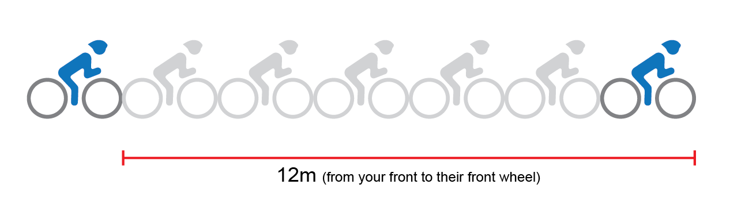
Draft Zones

Slide 37
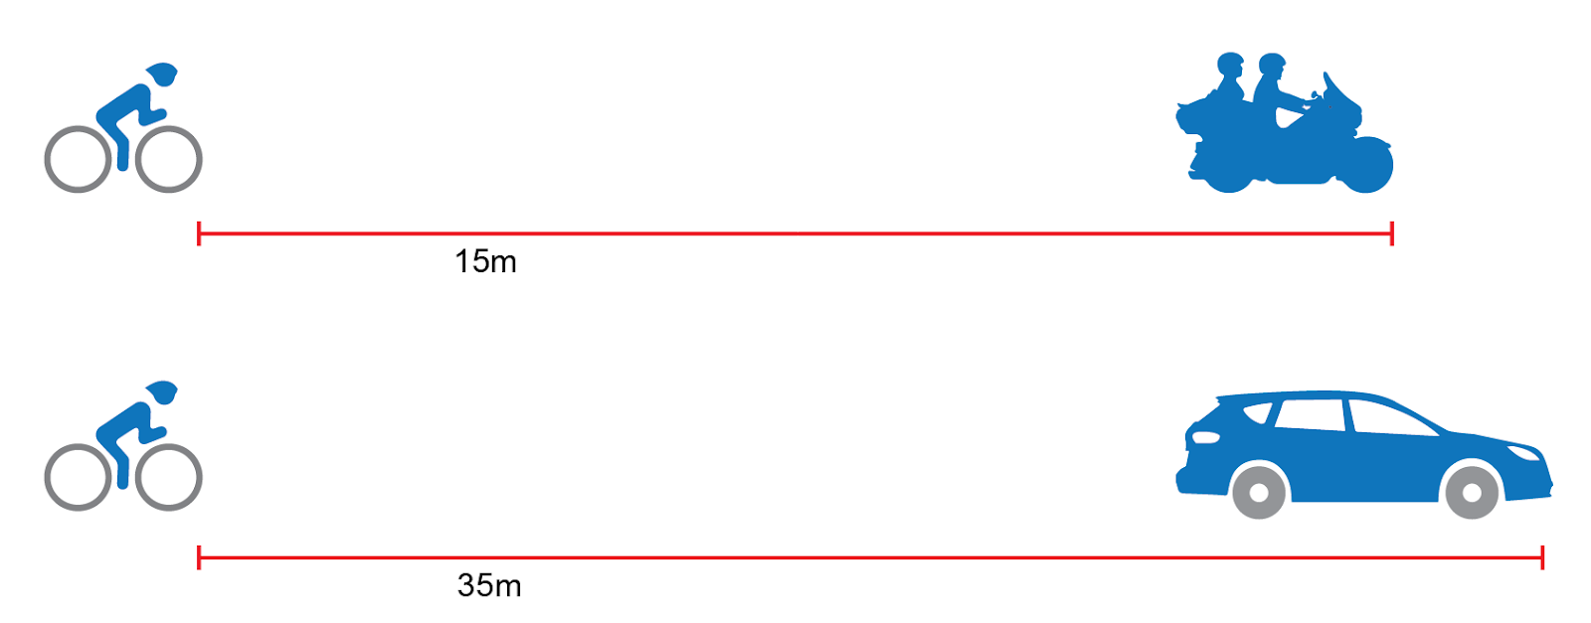

Draft Zones

Slide 38
Drafting Rules
An athlete may enter a bike draft zone in the following circumstances:
If the athlete enters the draft zone, and progresses through it within the allotted time in the process of overtaking;
For safety reasons;
100 meters before and after an aid station or transition area;
At an acute turn;

Slide 39
Drafting Rules
OVERTAKING:
An athlete is passed when another athlete's front wheel is ahead of theirs;
An overtaken athlete must drop out of the draft zone of the passing athlete by continuously make rearward progress out of the draft zone of the passing athlete. Re-passing by an overtaken athlete prior to dropping out of the draft zone will result in a drafting violation;
Overtaken athletes who remain within the draft zone of the passing athlete for more than the allotted time will be given a drafting violation;

Slide 40
Blocking Rules
Athletes must keep to the side of the course and not create a blocking incident;
Blocking is where an athlete who is behind cannot pass due to the leading athlete being poorly placed on the course;
Athletes seen blocking by a Technical Official will incur a time penalty of at the next bike penalty box.

Slide 41
Bike Infringements
During the Bike segment, Technical Officials can show 2 different cards (blue and yellow)
In case you receive a Blue card, you have to stop at the next penalty box for 5 minutes.
In case you receive a Yellow card, you have to stop at the next penalty box for 1 minute.
Drafting infringement
Other infringements
(blocking, littering, etc.)

Slide 42
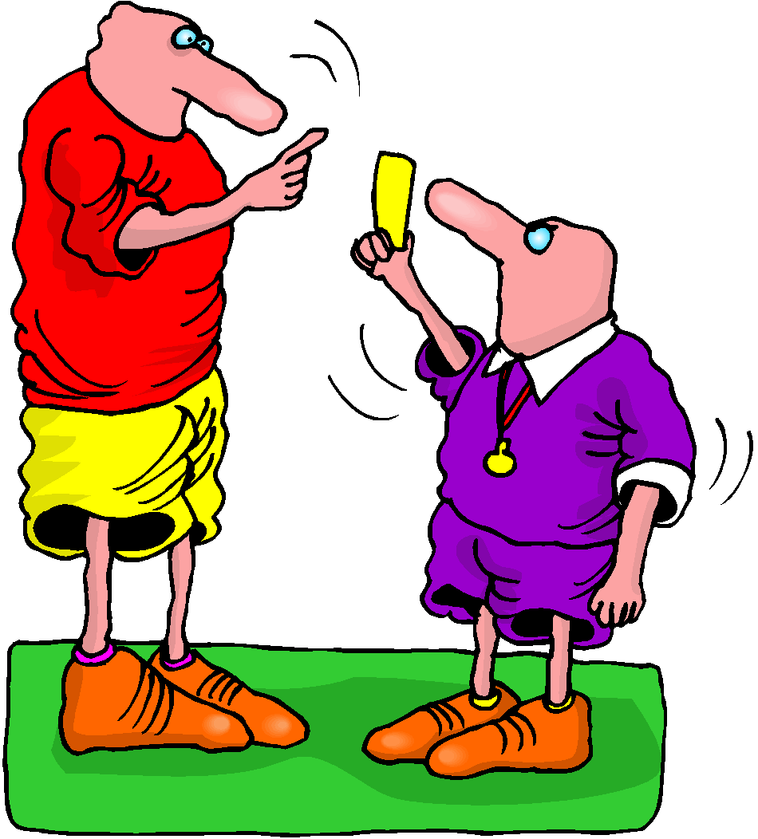
Advice of Penalties
The official will
Sound a whistle or horn
Show a BLUE / YELLOW card
Call your number
Advise you of the penalty
If you are shown a RED card, you are disqualified

Slide 43
Penalties
Stop in the next Penalty Box and stay there for 5 minutes
It is the athletes responsibility to stop in the next Penalty Box. Failing to do so will result in a DSQ
The penalties are accumulated. A third drafting offence will lead to a DSQ
1st and 2nd offences: 2 x 5 minutes in the Bike Penalty Box
3rd offence: DSQ

Slide 44
Penalties
The penalised athlete will enter the penalty box, dismount the bike and inform the Technical Official of their race number the number of penalties to serve and the colour of card(s) received.
The time penalty starts when the athlete complies with all above and ends when the Technical Official says “Go”, at which time the athlete may continue with the competition. If the athlete leaves the area, the Technical Official will ask the athlete to return and the time will be paused. Once the athlete complies the count will continue.
While in the bike penalty box, athletes can consume only the food and/or water that is on the athlete’s bike or person;
Athletes are prohibited from using the restroom while serving a penalty in the bike penalty box. The time of penalty will be paused while using the restroom;
Making adjustments to equipment or performing any type of bike maintenance while serving a penalty in the bike penalty box is prohibited.

Slide 45
Bike Infringement – REMEMBER
YELLOW CARD
1-MINUTE STOP
NEXT
PENALTY BOX
BLUE CARD
5-MINUTES STOP
NEXT PENALTY BOX
RED CARD
DSQ
3X BLUE CARDS

Slide 46
Penalty Box
<Insert details about the penalty box. Explain how the Officials will assess a Penalty >

Slide 47

Caution
Caution signal: three sharp whistles and red flags
Insert official World Triathlon event logo,
color version

Slide 48
Bike Course – Personal needs
Athletes may place their preferred nutrition items, spare bike tubes, Vaseline or any other items they may need in their Bike Personal Needs bags.
Please note these bags will NOT be returned to athletes after the race.
{Insert all the important information regarding the bike mechanical services on the course}
Insert official World Triathlon event logo,
color version

Slide 49
Bike Course – Mechanical Services
{Insert all the important information regarding the bike mechanical services on the course}
Insert official World Triathlon event logo,
color version

Slide 50
Transition Area 2
Traditional Bike Racks – numbered – every 75cm {update distance if necessary}
Orientation boards at the beginning of each rows
Go to your position in the transition area and rack your bike. Remember to keep your helmet fasten until your bike is racked. Athletes cannot touch the locking mechanism of their helmet from the time they remove their bike from the rack until they have placed it back on the rack and let go after the finish of the bike segment.
Go to the bags area:
  Take your Run bag, and put on your Run gear
  Place all your bike gear inside the bag (wetsuit, goggles, Swim cap)
  Leave the bag in the space {update if needed}
  There will be tents available per gender
  Make sure no equipment is left behind
Mount line on the {insert location} + {insert color}
Insert official World Triathlon event logo,
color version

Slide 51
Transition Flow
<Insert Swim Exit to TZ Map
Insert official World Triathlon event logo,
color version

Slide 52
Bike Exit to Run Entrance
<Insert map with Bike exit to TZ and the TZ to Run entrance flow >

Slide 53
Run course
<number of laps> laps (total distance of <total length of the bike in kilometer>km)
Aid stations:
  <number> per lap
  For locations see the map
  {include images for any drinks/food provided}
  Only discard bottles and litter within littering zones as indicated by
  the following signs
Uniform: Front zipper can be undone to the point of the end of the breastbone (sternum) during the competition, with the exception of the last 200 metres of the run, when it needs to be zipped up.
Insert official World Triathlon event logo,
color version

Slide 54
Run course
Coaches Area: {insert location}
  Coaches can supply athletes with their own food and beverages at the aid station and the coaches’ area.
Photo-finish
Bib number must be worn in front of the body
Insert official World Triathlon event logo,
color version

Slide 55
Run behavior
Definition from the World Triathlon CR §6.1:
Where an athlete makes accidental contact during the run with another athlete, then immediately moves away and does not cause a fall the athlete will not incur a penalty.
Where an athlete makes contact with another athlete during the run, continues to impede the progress of the other athlete and does not move away, the athlete will incur a time penalty.
Where an athlete deliberately targets another athlete during the run and impedes their progress, gains an unfair advantage, potentially causes harm or a fall the athlete will be disqualified and may be reported to the World Triathlon Tribunal for potential suspension or expulsion.
Insert official World Triathlon event logo,
color version

Slide 56
Run equipment - shoes
World Triathlon follows World Athletics' Shoe Regulations applicable to road events for all the triathlon and its other related multisports as described in 1.1.a);
Athletes are subject to random shoe control before, during, or after any competition. For any shoe that cannot be identified, each piece of information (and maybe the shoe itself) will be required to be sent to the World Triathlon headquarters for verification within 7 days after the competition it was worn.
In the official results, the athletes under shoe review will have a note (Uncertified/UNC) added to the results footer notes. If the shoe is confirmed as legal, the note will be removed. In any different case, the athlete will be disqualified.
Insert official World Triathlon event logo,
color version

Slide 57
Run Course Map
Insert Run Course Map (show locations of aid station, coaches’ area, finish chute & littering zones)
Insert official World Triathlon event logo,
color version

Slide 58
Run Penalty Box – ELITE ONLY
Start infringements will be served in T1
Swim, T1, Bike, T2 and Run Infringements will be served in Run
Location: {include the exact location}
Information: White board to show race numbers and letters to indicate violations
(Athletes need to read the board – coaches are advised to check and inform their athletes)
Procedure: 30/60 {select the exact seconds} time penalty per offence served on any lap of the run. If you do not stop – DSQ
Penalties must be posted prior to the last lap on the run. Any penalties following that point will be served on the spot.
Athletes have the option to decide whether to stop at the penalty box and serve the penalty or continue to the finish. Not stopping will result in DSQ on crossing the finish line. The athlete may then protest the penalty. Evidence will only be made available if a protest is filed.
Insert official World Triathlon event logo,
color version

Slide 59
Run Penalty Box – ELITE ONLY
Rule interpretation
Mount after the mount line: An athlete’s foot must contact the ground past the mount line, before the athlete mounts the bike. If this contact doesn’t occur, it is considered an infringement of the rules (M).
Dismount before the dismount line: An athlete’s foot must contact the ground before the dismount line after the athlete dismounts the bike. If this contact doesn’t occur, it is considered an infringement of the rules (D).
Discharge or store your equipment inside your designated area: Leaving the equipment (swim cap, goggles, helmet, etc.) in the designated box. If leaving the equipment outside the box, it is considered an infringement of the rules (E).
Insert official World Triathlon event logo,
color version

Slide 60
Run Penalty Box – ELITE ONLY
If you incur a penalty, you will find your number plus a letter code indicating the nature of the infraction:
Violations Abbreviations:
For example:
Dismount Line | D |  | Littering | L
Mount Line | M |  | Equipment outside the box | E
Swim Behavior | S |  | Bike Behavior | B
Run Behavior | R |  | Other violations | V
12 D | athlete #12 received a time penalty for a dismount line violation
12x2 ME | athlete #12 received 2-time penalties for mount line and equipment outside the box violations
Insert official World Triathlon event logo,
color version

Slide 61
Right to protest
An Athlete who receives a penalty may protest, with the exception of:
  (i) a penalty for a drafting violation; and
  (ii) a time penalty which has already been served.
If an athlete serves a time penalty, the athlete accepts the penalty, and no protest will be admitted.
If an athlete does not serve a time penalty, he/she will be disqualified but may protest against the disqualification and the decision of the Head Referee to issue the time penalty.

Slide 62
Post-race Procedures
Photo finish
When you finish, keep moving through to the “Mixed Zone” and recovery area.
Anti-Doping Control: photo ID is needed for every athlete to have ready for Doping Control
For awards, dress “up” with race uniform or country clothes
Insert official World Triathlon event logo,
color version

Slide 63
Post-race Procedures
Only LOC Medical Staff area allowed in the medical area.
The NF accredited doctor is allowed in the medical area only when an athlete from their country is in the area.
Insert official World Triathlon event logo,
color version

Slide 64
Timing
Electronic Timing System will be used
Secure your timing chip on your ankle: Losing your timing chip will affect your electronic results and a fee will be levied
Retired Athletes return timing chip to Technical Officials
Insert official World Triathlon event logo,
color version

Slide 65
Bike check-out
{Insert all the important information regarding the bike check-out}
Insert official World Triathlon event logo,
color version

Slide 66
Medal Ceremony - ELITE
{Insert all the important information regarding the medal ceremony for the medalists and the attendances}
As per the World Triathlon Competition rules:
2.8 c.) (i) Athletes must wear the uniform during the entire competition and award ceremony. Long sleeves and long pants are allowed for the award ceremony
Elite athletes are not allowed to carry their country flag on the podium; there will be flags raising with the playing of the national anthem of the winner.
Insert official World Triathlon event logo,
color version

Slide 67
Medal Ceremony - AG
{Insert all the important information regarding the medal ceremony for the medalists and the attendances}
As per the World Triathlon Competition rules:
2.8 c.) (i) Athletes must wear the uniform during the entire competition and award ceremony. Long sleeves and long pants are allowed for the award ceremony
Kids are not allowed on the podium.
If you can not attend the medal ceremony, your Team Manager or one of your teammates should pick up your medal at the end of the ceremony.
Insert official World Triathlon event logo,
color version

Slide 68
Ambush Marketing Rules
For ceremony awards, please observe the ambush marketing rules
Ambush marketing is defined as:
“Deliberately using the opportunity of live television and media photographers to acquire additional exposure for your sponsor product, apparel or brand.”
The consequence for this behavior is: (if applicable)
The athlete will immediately forfeit their prize money for that event.
Insert official World Triathlon event logo,
color version

Slide 69
Closing Ceremony
{Insert all the important information regarding the closing ceremony for the medalists and the attendances}
Insert official World Triathlon event logo,
color version

Slide 70
Coaches Accreditation / Coaches Areas
Accreditation
  All coaches have to collect accreditation to be able to enter the venue. venue – a picture ID needed.
  Only Coaches/Support Crew who have been registered from their NF into the World Triathlon online system are entitled for an accreditation
  Support to the athletes is composed by the following categories: Coaches, Medical, Bike Mechanic, Ski man and NF representatives. World Triathlon may add other categories if needed in a specific event . The people entered in the categories of Coaches and Medical must complete the Anti-Doping Education course.
Coaches’ areas
  Behind / beside / at <location> {describe exactly, choose the correct)
  Show map if available
Insert official World Triathlon event logo,
color version

Slide 71
Important updates
{If applicable}
Insert official World Triathlon event logo,
color version

Slide 72
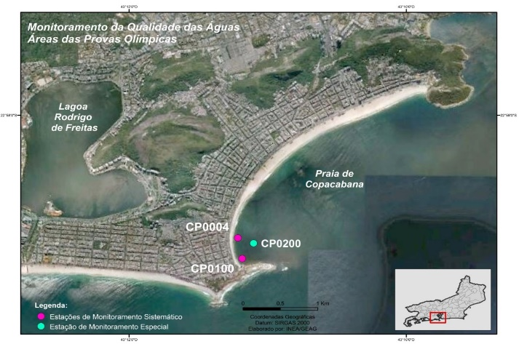
Water Quality Assessment (Sea/Transition)
{select the appropriate}
Update orange text accordingly
Enterococci
Insert Sample Date | NMP/100mL
Location A | 10
Location B | 10
Location C | 10
Enterococci limit | <100
E.Coli
Insert Sample Date | NMP/100mL
Location A | 80
Location B | 80
Location C | 80
E.Coli limit | <250
PH
Insert Sample Date
Location A | 7
Location B | 7
Location C | 7
PH limit | 6-9
Weather forecast
Day | Weather
Briefing (B) | Overcast with light rain
B +1 | Overcast (20% chance of rain
Race Day | Overcast (20% chance of rain
Weather report
Day | Weather
B-3 | Heavy rain in the evening
B-2 | Sunny
B-1 | Sunny
Visual Sanitary Inspection (last 12 hours)
Location | Visual Pollution | Odour | Time of visit | Comments
Location | None | None | 09:15 | Insert comments if necessary
SUMMARY
Add text from competition rules – 10.3.f.i or 10.3.g.i YOU CAN FOUND IT IT THE SLIDE NOTES BELOW, eg. 3 = ‘Fair Water Quality’: (E.Coli: 250 to 500 or Enterococci 100 to 200), but with potential or poor visual pollution during sanitary check and/or potential for forecast of heavy rain;
Insert official World Triathlon event logo,
color version
Notes:
Water Quality Decision Matrix (Sea and Transition water)
1 = ‘Very Good Water Quality’: (E.Coli < 250 or Enterococci < 100) with no or potential visual pollution during sanitary check or forecasted heavy rain;
2 = ‘Good Water Quality’: (E.Coli < 250 or Enterococci < 100) with poor visual pollution during sanitary inspection or forecasted heavy rain;
2 = ‘Good Water Quality’: (E.Coli: 250 to 500 or Enterococci 100 to 200) but with no or potential visual pollution during sanitary inspection or forecasted heavy rain;
3 = ‘Fair Water Quality’: (E.Coli: 250 to 500 or Enterococci 100 to 200), but with potential or poor visual pollution during sanitary check and/or potential for forecast of heavy rain;
4 = ‘Poor Water Quality’: (E.Coli > 500 or Enterococci > 200), with any visual pollution during sanitary check and/or potential for forecast of heavy rain.
Water Quality Decision Matrix (Inland water)
1 = ‘Very Good Water Quality’: (E.Coli < 500 or Enterococci < 200) with no or potential visual pollution during sanitary check or forecasted heavy rain;
2 = ‘Good Water Quality’: (E.Coli < 500 or Enterococci < 200) with poor visual pollution during sanitary inspection or forecasted heavy rain;
2 = ‘Good Water Quality’: (E.Coli: 500 to 1000 or Enterococci 200 to 400) but with no or potential visual pollution during sanitary inspection or forecasted heavy rain;
3 = ‘Fair Water Quality’: (E.Coli: 500 to 1000 or Enterococci 200 to 400), but with potential or poor visual pollution during sanitary check and/or potential for forecast of heavy rain;
4 = ‘Poor Water Quality’: (E.Coli > 1000 or Enterococci > 400), with any visual pollution during sanitary check and/or potential for forecast of heavy rain.

Slide 73
Water Quality Assessment (Inland)
{select the appropriate}
Update orange text accordingly
Enterococci
Insert Sample Date | NMP/100mL
Location A | 10
Location B | 10
Location C | 10
Enterococci limit | <200
E.Coli
Insert Sample Date | NMP/100mL
Location A | 80
Location B | 80
Location C | 80
E.Coli limit | <500
PH
Insert Sample Date
Location A | 7
Location B | 7
Location C | 7
PH limit | 6-9
Weather forecast
Day | Weather
Briefing (B) | Overcast with light rain
B +1 | Overcast (20% chance of rain
Race Day | Overcast (20% chance of rain
Weather report
Day | Weather
B-3 | Heavy rain in the evening
B-2 | Sunny
B-1 | Sunny
Visual Sanitary Inspection (last 12 hours)
Location | Visual Pollution | Odour | Time of visit | Comments
Location | None | None | 09:15 | Insert comments if necessary
SUMMARY
Add text from competition rules – 10.3.f.i or 10.3.g.i YOU CAN FOUND IT IT THE SLIDE NOTES BELOW, eg. 3 = ‘Fair Water Quality’: (E.Coli: 250 to 500 or Enterococci 100 to 200), but with potential or poor visual pollution during sanitary check and/or potential for forecast of heavy rain;
Insert official World Triathlon event logo,
color version
Notes:
Water Quality Decision Matrix (Sea and Transition water)
1 = ‘Very Good Water Quality’: (E.Coli < 250 or Enterococci < 100) with no or potential visual pollution during sanitary check or forecasted heavy rain;
2 = ‘Good Water Quality’: (E.Coli < 250 or Enterococci < 100) with poor visual pollution during sanitary inspection or forecasted heavy rain;
2 = ‘Good Water Quality’: (E.Coli: 250 to 500 or Enterococci 100 to 200) but with no or potential visual pollution during sanitary inspection or forecasted heavy rain;
3 = ‘Fair Water Quality’: (E.Coli: 250 to 500 or Enterococci 100 to 200), but with potential or poor visual pollution during sanitary check and/or potential for forecast of heavy rain;
4 = ‘Poor Water Quality’: (E.Coli > 500 or Enterococci > 200), with any visual pollution during sanitary check and/or potential for forecast of heavy rain.
Water Quality Decision Matrix (Inland water)
1 = ‘Very Good Water Quality’: (E.Coli < 500 or Enterococci < 200) with no or potential visual pollution during sanitary check or forecasted heavy rain;
2 = ‘Good Water Quality’: (E.Coli < 500 or Enterococci < 200) with poor visual pollution during sanitary inspection or forecasted heavy rain;
2 = ‘Good Water Quality’: (E.Coli: 500 to 1000 or Enterococci 200 to 400) but with no or potential visual pollution during sanitary inspection or forecasted heavy rain;
3 = ‘Fair Water Quality’: (E.Coli: 500 to 1000 or Enterococci 200 to 400), but with potential or poor visual pollution during sanitary check and/or potential for forecast of heavy rain;
4 = ‘Poor Water Quality’: (E.Coli > 1000 or Enterococci > 400), with any visual pollution during sanitary check and/or potential for forecast of heavy rain.

Slide 74
Heat stress indicators
Warning flags will be placed at the athletes’ area and behind the spectators’ stands

Slide 75
Weather forecasts
 | Temperature in °C | Weather
Friday | <insert data> | <insert data>
Saturday | <insert data> | <insert data>
Sunday | <insert data> | <insert data>
Insert official World Triathlon event logo,
color version

Slide 76


Slide 77
Have a good race!

